Slide 1
Apple Store vs Google Play

Slide 2
Which Review matters??
Client at a marketing consultancy firm wants to designs operating systems, and they want to build a major apps store into their user interface. To this end, they want to know whether Google Play apps have higher reviews on average than Apple Store apps (or vice versa), as they’re intending to strike a deal with just one of these companies.
In this project, the goal is to see if Apple Store apps receive better reviews than Google Play apps.

Slide 3
Steps Involved
Sourcing and loading
Cleaning, transforming and visualizing
Modelling
Evaluating and concluding

Slide 4
Sourcing and loading
Load the two datasets – Google and apple
Pick the columns that are necessary for analysis – Rating, Reviews and Price
Subsetting the data on this basis

Slide 5
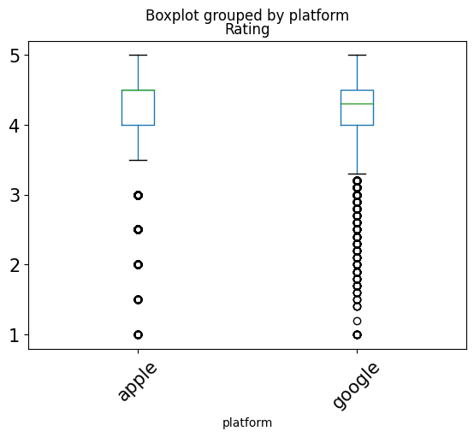
Cleaning, transforming and visualizing
Check the data types and fix them
Add a platform column to both the Apple and the Google dataframes
Changing the column names to prepare for a join
Join the two data sets
Eliminate the NaN values
Filter only those apps that have been reviewed at least once
Summarize the data visually and analytically (by the column platform)

Slide 6
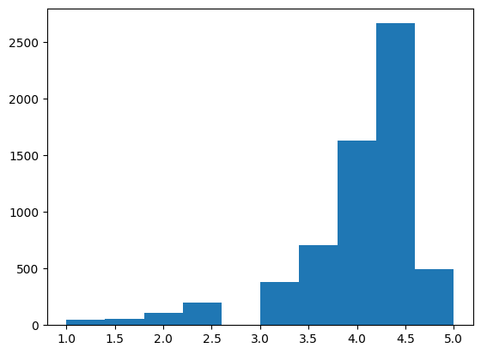
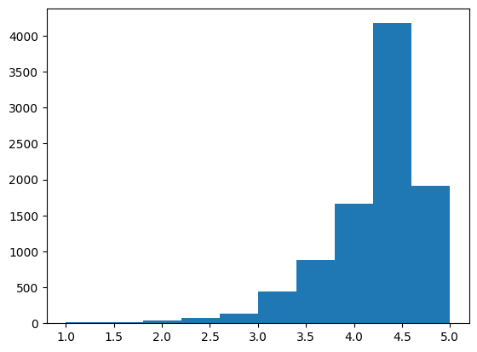
Modelling
Hypothesis formulation
Getting the distribution of the data
Non-parametric test on permutation sample
Distribution of Apple
Distribution google Apple

Slide 7
Evaluation & Conclusion
After doing non-parametric tests on the permutation sample, it was found that zero differences are at least as extreme as our observed difference!
So the p-value of our observed data is 0.
It doesn’t matter which significance level we pick; our observed data is statistically significant, and we reject the Null.
We conclude that the platform does impact ratings. Specifically, we should advise our client to integrate only Google Play into their operating system interface.

